Slide 1
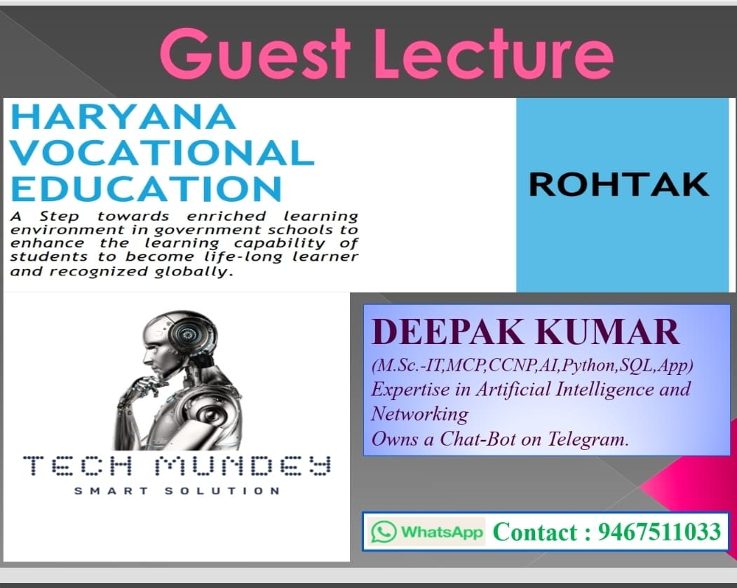

Slide 2
Chat GPT
What you will learn?
History and Definition of ChatGPT.
How ChatGPT Works.
How students can use ChatGPT?
Advantages and Limitations of ChatGPT.

Slide 3
Definition of ChatGPT
History-
ChatGPT was developed by OpenAI, an AI research company founded by Elon Musk and Sam Altman in 2015, and launched on November 30, 2022.
Definition-
ChatGPT is an artificial intelligence (AI) chatbot that uses machine learning to process data and generate responses to user questions. It can answer questions, solve math problems, translate languages, and more.
Full Form- Generative Pre-training Transformer

Slide 4
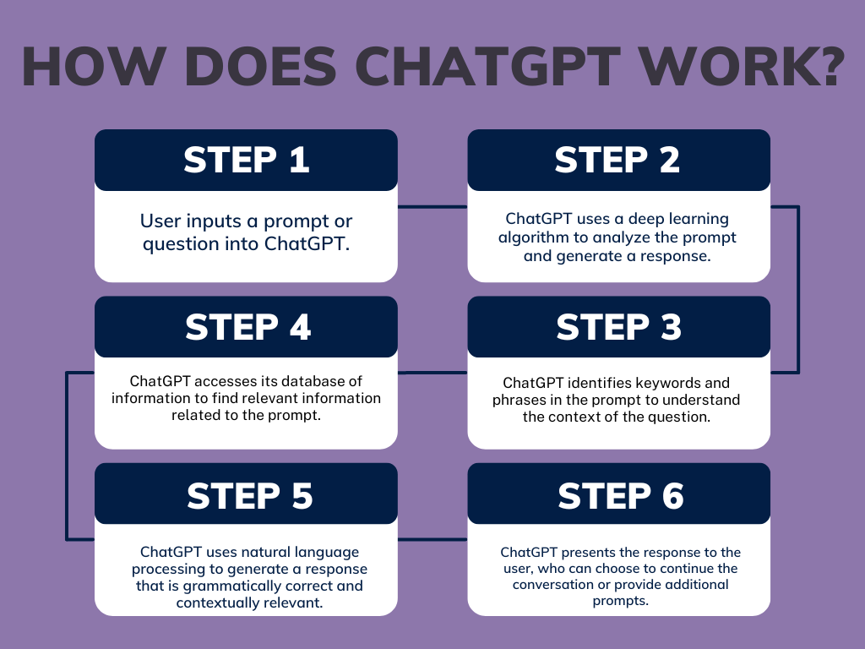
How ChatGPT Works

Slide 5
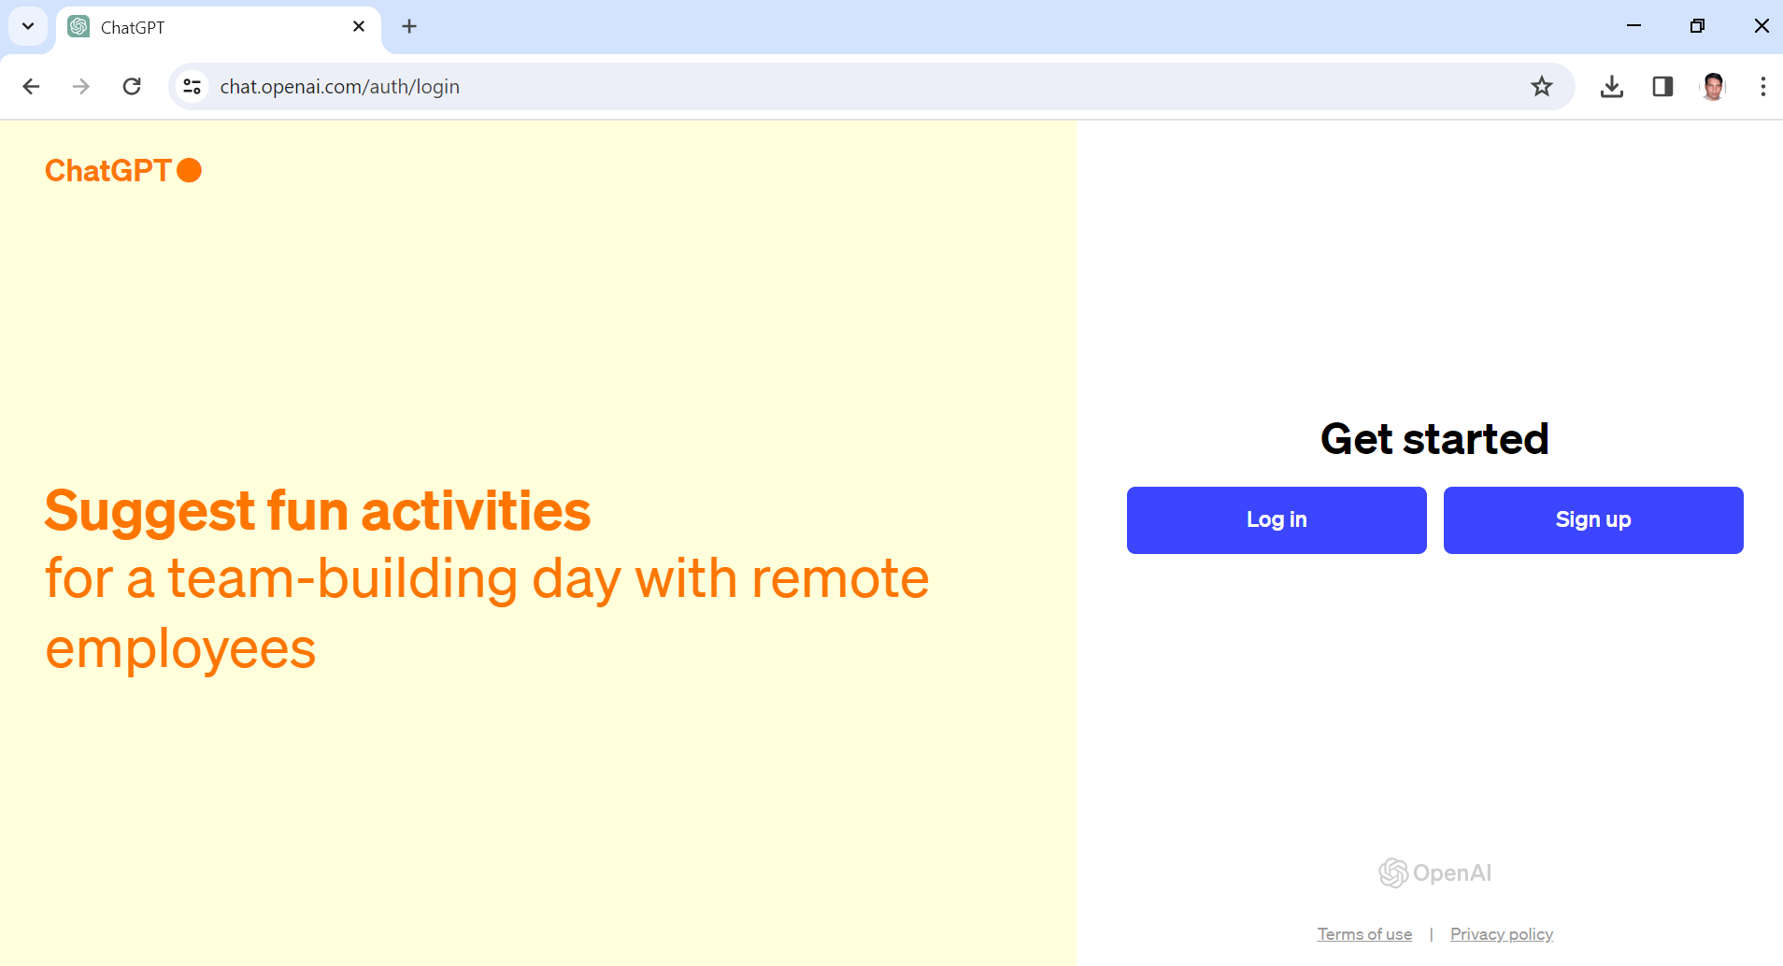
How students can use ChatGPT?

Slide 6
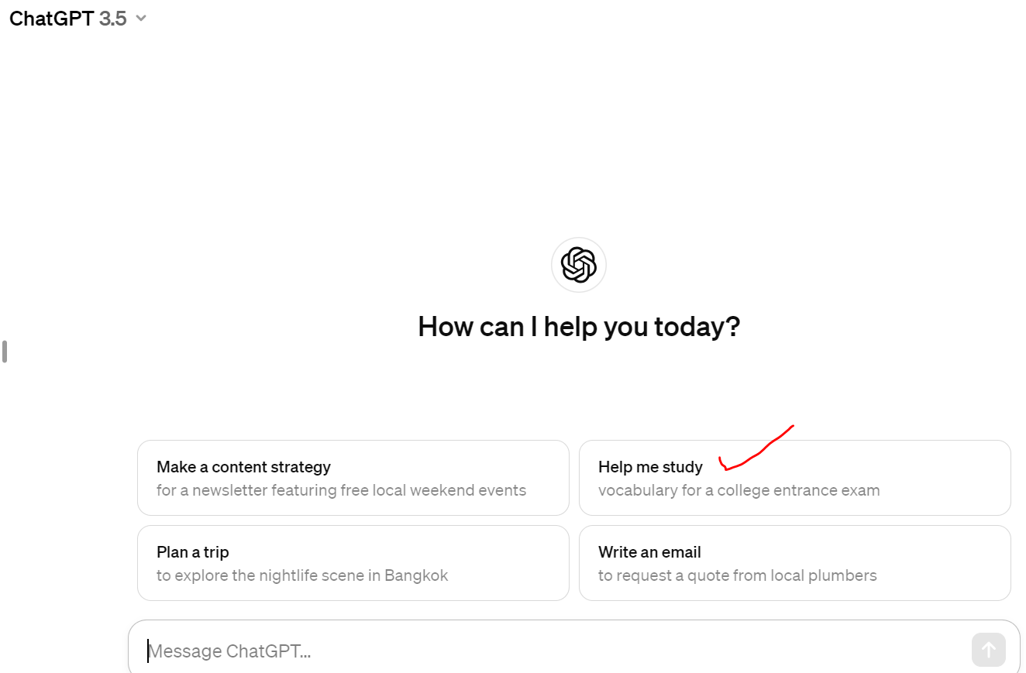

Slide 7
Advantages of ChatGPT
Advantages:
Versatility: ChatGPT can discuss a wide range of topics, from scientific concepts to everyday conversation, making it adaptable to various contexts.
Availability: It's accessible 24/7, providing instant assistance and information whenever needed.
Language Support: ChatGPT supports multiple languages, aiding communication with users from different linguistic backgrounds.
Vast Knowledge: Trained on a diverse dataset, ChatGPT has a vast repository of information at its disposal, enabling it to answer a wide array of questions.
Personalization: It can adapt responses based on the user's input, providing tailored information or assistance.
Learning: Through interactions, ChatGPT can learn and improve its responses over time, enhancing its effectiveness.

Slide 8
Limitations of ChatGPT
Limitations:
Lack of Contextual Understanding: While proficient in generating text, ChatGPT may sometimes lack a deep understanding of context, leading to occasional inaccuracies or misunderstandings.
Inability to Verify Information: It doesn't have access to real-time data or the ability to verify the accuracy of information, which can lead to reliance on outdated or incorrect data.
No Emotional Intelligence: ChatGPT lacks emotional intelligence and cannot perceive or respond to emotions, which may be necessary in certain interactions.
Potential for Bias: Like any AI model, ChatGPT may exhibit biases present in its training data, which can influence its responses.
Limited Creativity: While capable of generating text, ChatGPT's creativity is limited compared to human beings, making it less suitable for tasks requiring originality or nuanced creativity.
Security Concerns: Engaging with AI models like ChatGPT may pose security risks if sensitive information is shared without appropriate precautions

Slide 9
Conclusion:
Recap of key points
Q&A:
Open AI is founded by ___________ and ____________in 2015.
Open AI was launched on _____________, 2022.
Full form of ChatGPT is _____________________________.
Speak about any two Advantages of ChatGPT.
Speak about any two Limitation of ChatGPT.

Slide 10
Acknowledgement for your participation
"Before we conclude, I would like to take a moment to express my sincere gratitude to each and every one of you for your active participation throughout this session. Your insightful questions, comments, and contributions have truly enriched our discussion and made this presentation even more engaging. It's been a pleasure interacting with such an attentive and enthusiastic audience.
Your participation underscores the importance of collaboration and exchange of ideas in our journey towards understanding and harnessing the power of AI conversational agents like ChatGPT. Your curiosity and engagement inspire us to continue pushing the boundaries of technology and exploring new possibilities.
So, from the bottom of my heart, thank you for your valuable input and for being an integral part of today's presentation. Let's continue this dialogue and work together towards a future where AI-driven communication transforms our world for the better.
Thank you once again."

Slide 11


